Slide 1
The Mixed Strategy for Chinese Standard Mahjong AI
Team: DX
Team Member: Chenglu Sun, Yu Zhang, Wei Zhou, Sijia Xu
Reported by Chenglu Sun

Slide 2
Introduction
Main difficulties：
Need over 8 Faan points
Over 80 Faan types
Imperfect information
Huge state space
Sparse reward
Less relevant research
Solutions：
Reinforcement Learning
Behivour Tree
Search Algorithm

Slide 3
Botzone
input:
{"requests":["0 0 2","1 0 0 0 0 J1 T6 W9 B1 T6 F1 W5 B2 W4 T8 B5 W2 T5","2 W6","3 0 PLAY B1"],"responses":["PASS","PASS","PLAY B1"]}
output:
{"response":"PLAY B1"}
scores:
Winner：
Win by self-draw：(8 + Winning Points)×3
Win by a discard tile from other players：8 × 3 + Sum of Faan Points
Loser:
The winning tile provider: - (8 + Sum of Faan points)
Not the winning tile provider: - 8
The winner wins by self-drawn: - (8 + Sum of Faan points)

Slide 4
Information induction
2-D Hand Tiles^{[1]}:
1-D Hand Tiles: [5, 5, 5, 9, 10, 11, 21, 22, 23, 29, 29, 29, 31, 31]
Observations:
1. Hand tiles
2. Melds
3. Discard tiles
4. Other information extracted from the above states, such as shown tiles and undiscovered tiles
[1]. Junjie Li, Sotetsu Koyamada, Qiwei Ye, Guoqing Liu, Chao Wang, Ruihan Yang, Li Zhao, Tao Qin, Tie-Yan Liu, Hsiao-Wuen Hon. Suphx: Mastering Mahjong with Deep Reinforcement Learning. 2020

Slide 5
Information induction
Discard model：
used for discarding tiles
Observation:
52 * 34
Action:
34 one-hot
Judge model：
used for Chow, Pong and Kong operations
Observation:
64 * 34
Action:
bool
Algorithm:
PPO + GAE
self-play without pretraining
Reward:
winner：Faan points / 8
Others：0

Slide 6
Interaction logic
learner
sampler
Worker
learner
Learner
PPO
trajectories
Worker_0
…
Net
Game_0
Game_n
CNN
Worker_1
parameters
…
Agent_0
State,
Action,
Reward,
…
Worker_n
Agent _1
parameters
outcomes
model
parameters
Agent _2
coordinator
Agent _3
8 gpus + 256 cpus 14 cnn layers and 3 dense layers

Slide 7
Policy types
We simply make the Chinese Standard Mahjong polices have the following categories,
Special Faans: (Greater) Honours and Knitted Tiles, Seven Pairs, thirteen orphans
Three Chows: Mixed Shifted Chows, Pure Shifted Chows, Pure Straight, Mixed Straight, Mixed Triple Chow
All Types: All Types
Flush: Half Flush, Pure Flush
All Pungs: All Pungs
Outside Hand: Outside Hand
Others: all Faans
Finally, we decided to apply the RL method to learn the Three Chows, All Types, All Pungs and others categories.

Slide 8
Behavior tree
Sub-model control
Special Faans
Three Chows
All Types
Flush
All Pungs
Outside Hand
Others
At the beginning, we applied the behavior tree to handle the Special Faans, Outside Hand, and sub-model control part. Other sub-models are obtained by RL.
Finally, we also used behavior tree to realize the Three Chows, All Pungs and All Types.

Slide 9
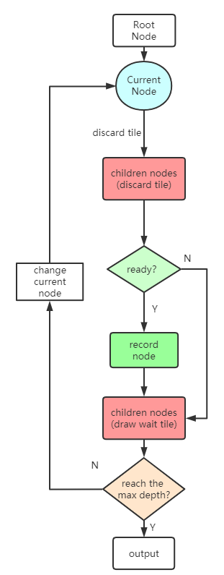
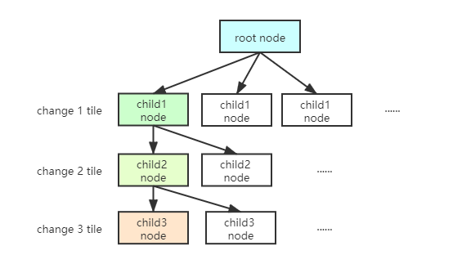
Search Algorithm
Node
Hand tiles
Discard tile
Draw tile
Parent Node
Shan Ten
For each cycle, once we get the Record Node which means it’s possible to win in the next several round, output the discard tile of the chosen node.
The depths of the search tree indicate how many rounds. The smaller the better.

Slide 10
Bot evolution
Phase 1: Pure reinforcement learning model (100%)
Rank: about 1100 scores
Phase 2: Reinforcement learning model (90%) + Behavior tree (10%)
Rank: about 1150 scores
Phase 3: Reinforcement learning model (20%) + Behavior tree (80%)
Rank: about 1250 scores
Phase 4: Reinforcement learning model (20%) + Behavior tree (60%) + Search algorithm (20%)
Rank: not stable yet

Slide 11
Bot Composition
Sub-model | Cover Faans | method
Special Faans | (Greater) Honours and Knitted Tiles, Seven Pairs, thirteen orphans | Behavior tree
Three Chows | Mixed Shifted Chows, Pure Shifted Chows, Pure Straight, Mixed Straight, Mixed Triple Chow | Behavior tree
All Types | All Types | Behavior tree
Flush | Half Flush, Pure Flush | RL model
All Pungs | All Pungs | Behavior tree
Outside Hand | Outside Hand | Behavior tree
Others | All other Faans | Search algorithm

Slide 12
summary
Advantage:
1. The running speed is fast, and there will be no decision timeout.
2. Low coupling, easy to modify, and convenient to add new strategies. Bot's behavior is easy to control.
Disadvantages:
1. Employed lots of behavior trees, which can not be used in other scenarios.
2. The sub-model control part applied some hyperparameters, which have great effects on the bot.
If you have any questions, please feel free to contact my individual E-mail, sdsgscl@163.com

Slide 13
Thank you !

